Slide 1
Exp.16 Electrostatics
Phys 222 Lab for Science and Engineering, University of Mississippi
TA: Kevin Yi-Wei Lin
2016/2/1

Slide 2
Syllabus
TA: Kevin Yi-Wei Lin (kiln@go.olemiss.edu)
I’m from Taiwan! Not a native English speaker
Tutoring hour: Wed 9-10 @ Lewis 104
My PPT will be posted on Blackboard
Please review the lab report format
There’s a Final in Phys222, check the website for more info. Note that you will be tested individually with written and practical test.

Slide 3
Late Policy
Late lab reports and prelabs are penalized 10% per week up

Slide 4
Lab Report Format
This one is 100pts!

Slide 5
Electrostatics
Two kinds of charged: positive(proton, glass rubbed with silk) and negative(electron, ebonite rubbed with fur)
Slightly excess of one makes an object charged
Opposites attract. And likes repel.
Charge Conservation: Rather than being created or destroyed, charges are solely moved from one to another.
If you move an electron out of a neutral object, it will have one excess positive charge. The sum of charges remains the same.
In regular solid, charges are transferred only by moving electrons. Atom cores are almost stationary.

Slide 6
Electrostatics
Two kinds of charged: positive(proton, glass rubbed with silk) and negative(electron, ebonite rubbed with fur)
Slightly excess of one makes an object charged
Opposites attract. And likes repel.
Charge Conservation: Rather than being created or destroyed, charges are solely moved from one to another.
If you move an electron out of a neutral object, it will have one excess positive charge. The sum of charges remains the same.
In regular solid, charges are transferred only by moving electrons. Atom cores are almost stationary.

Slide 7
Electrostatics
Two kinds of charged: positive(proton, glass rubbed with silk) and negative(electron, ebonite rubbed with fur)
Slightly excess of one makes an object charged
Opposites attract. And likes repel.
Charge Conservation: Rather than being created or destroyed, charges are solely moved from one to another.
If you move an electron out of a neutral object, it will have one excess positive charge. The sum of charges remains the same.
In regular solid, charges are transferred only by moving electrons. Atom cores are almost stationary.

Slide 8
Conductor & Insulator
Conductor
Electrons inside are freely to move across the bulk, and also onto other object if in contact. Electric currents are allowed to flow inside.
Large charge separation/polarization can be induced
Eg. Two spheres in the previous slide
Insulator
Electrons are localized within individual atoms. Electric current is near impossible to flow.
Only small electric dipoles can be induced
Eg. Charged balloon on wall

Slide 9
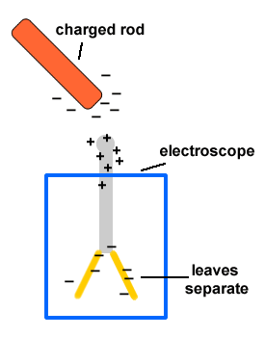
Gold-leaf Electroscope
Used to detect the presence of charged objects by observing the separation of leaves
Also can be used to determine if the charges stored inside the electroscope are the same type with foreign object.
Again, Opposites attract, and likes repel for the leaves

Slide 10
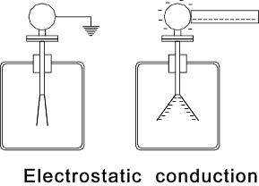
Electrostatic Conduction
Result in charging the same type of charge as the charged object
Grounding, by hand

Slide 11
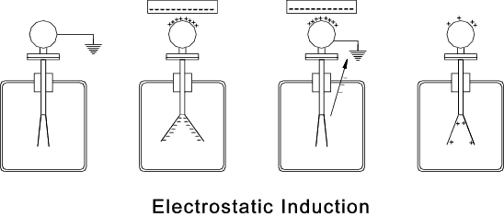
Electrostatic Induction
Result in charging the opposite type of charge to the charged object

Slide 12
Experiment Outline
Part I: Behavior of a conductor/insulator in the presence of a charged object
Part II: Charging an electroscope by conduction
Part III: Charging an electroscope by induction
Part IV: Charged electroscope under the influence of flame

Slide 13
Notes
This experiment will be harder to perform with large humidity. Use hair dryer on the apparatus if necessarily
Ground your electroscope by hand every time you start a new experiment

Slide 14
Data
Your are going to draw a diagram for every steps in the procedure (for step one, two diagrams), 9 total.
Each diagram includes: a) initial net charge, b) charge separation c) charge transfer d) final net charge
Before you leave show me those diagrams
Those above are DATA. Penalty for putting in result presentation

Slide 15
Result Presentation
For result presentation, write qualitative descriptions for each part.
You can explain the mechanism behind those observed phenomenon in Discussion

Slide 16
Procedure
Paper scrap and pith ball
This lab is pretty straight forward. I’ll let you guys read it yourselves and begin!
If there’s anything unclear to you, just ask!

